Slide 1
CPU Organization Course day 3
Alexander Titov
26 December 2014

Slide 2
Course Roadmap
Day 1
Pipeline
Memory Hierarchy (Caches)
Day 2
Out-of-order execution
Branch prediction
Day 3
Real example: Haswell Microarchitecture

Slide 3
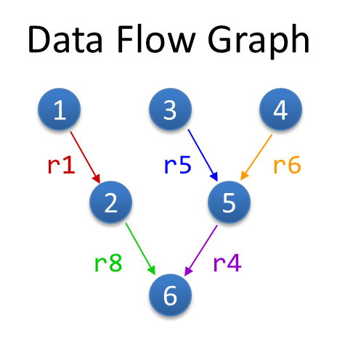
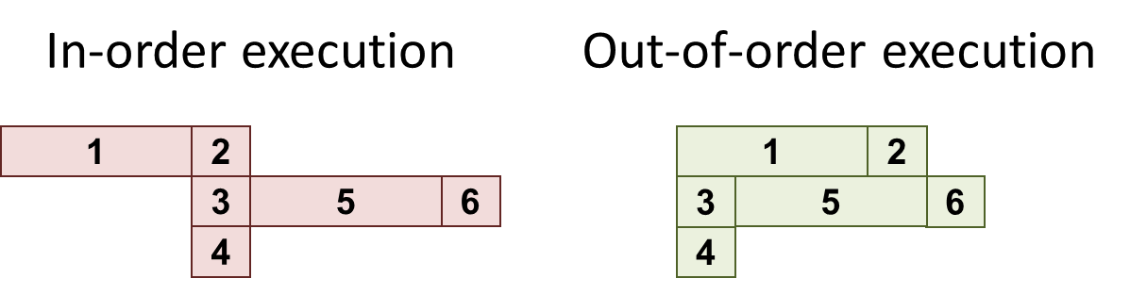
Refresher: OOO Exe
Superscalar – wide pipeline (4-5 in modern CPU)
Out-of-order – execute according real dependencies (“data flow”) rather than program order
Advantages:
Extract parallelism from the sequential instr stream
Hide latencies (e.g., cache misses)
Need to maintain visibility of in-order execution
Precise exceptions, memory model, etc.

Slide 4
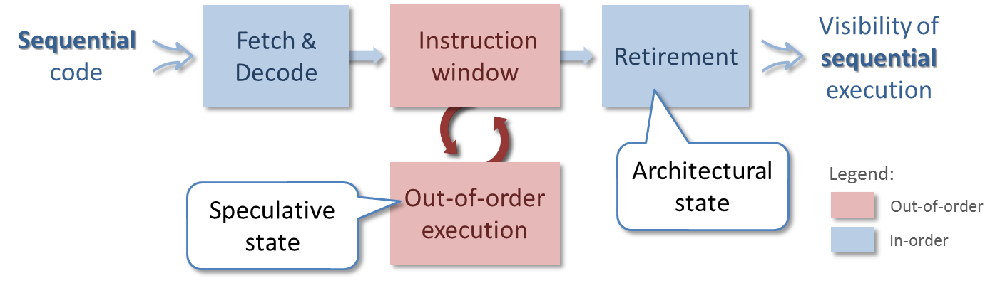
Refresher: OOO Exe
Two states are supported: speculative and architectural
Instruction window (ROB) keeps all in-flight instructions and allows order reconstructions
The large window the better performance
Limitations:
False dependencies -> rename registers
Branches -> accurate dynamic prediction

Slide 5
Intel Processor Roadmap
from wikipedia.org
Tick-Tock model
A new microarchitecture (Tock) is followed by process compaction (Tick)

Slide 6
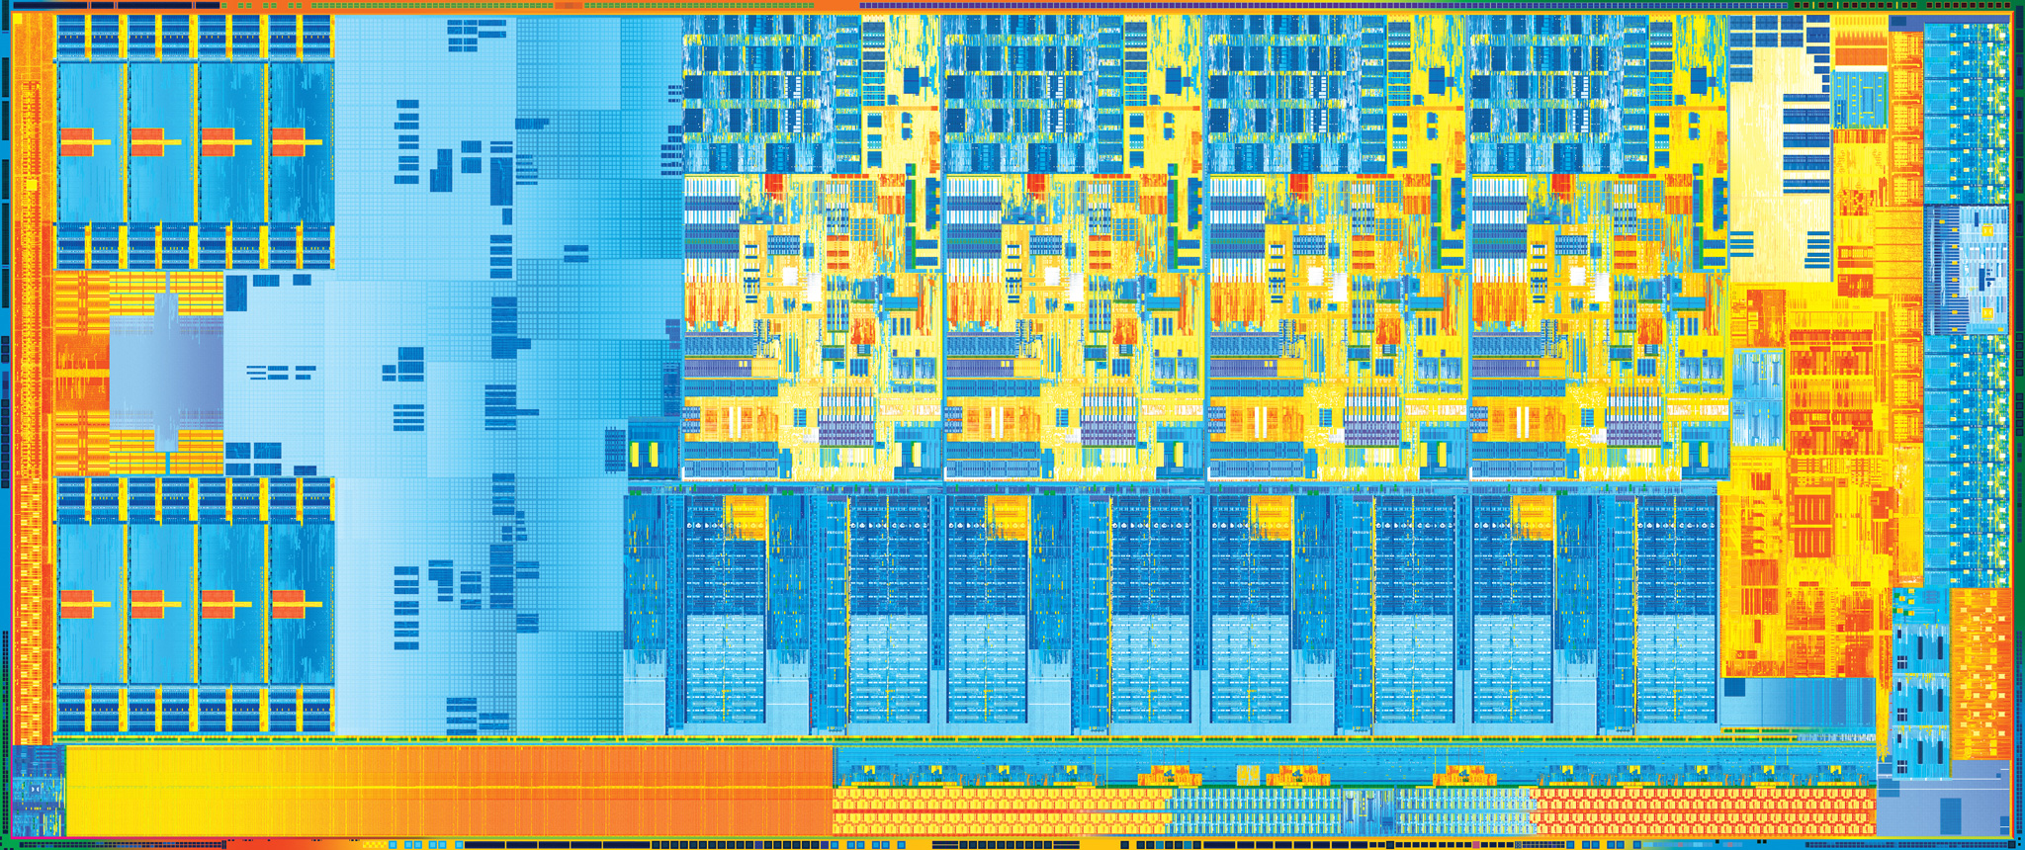
Haswell FloorPlan
Core
Core
Core
Core
System Agent
&
Memory Controller
Processor
Graphics
Shared L3 Cache
22nm process
1.4 Billion transistors
Die size: 160 mm2

Slide 7
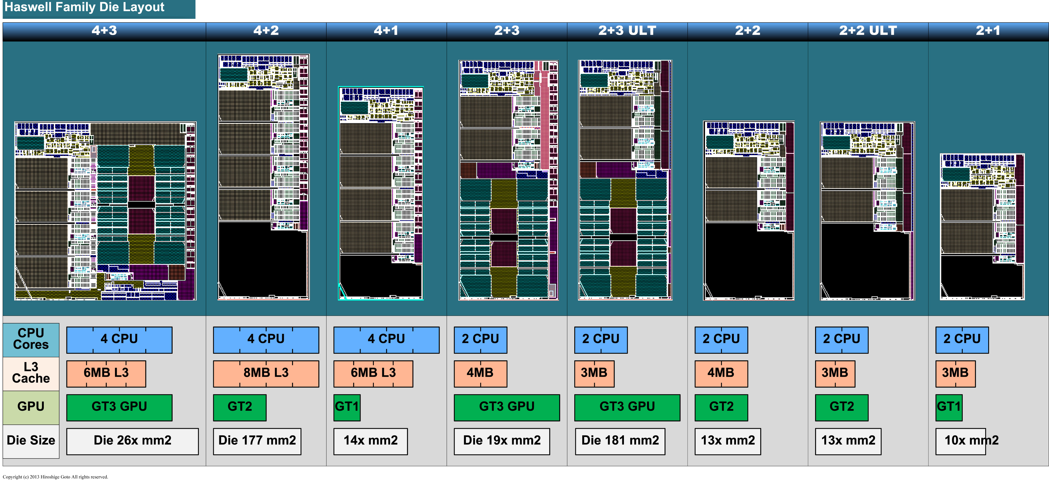
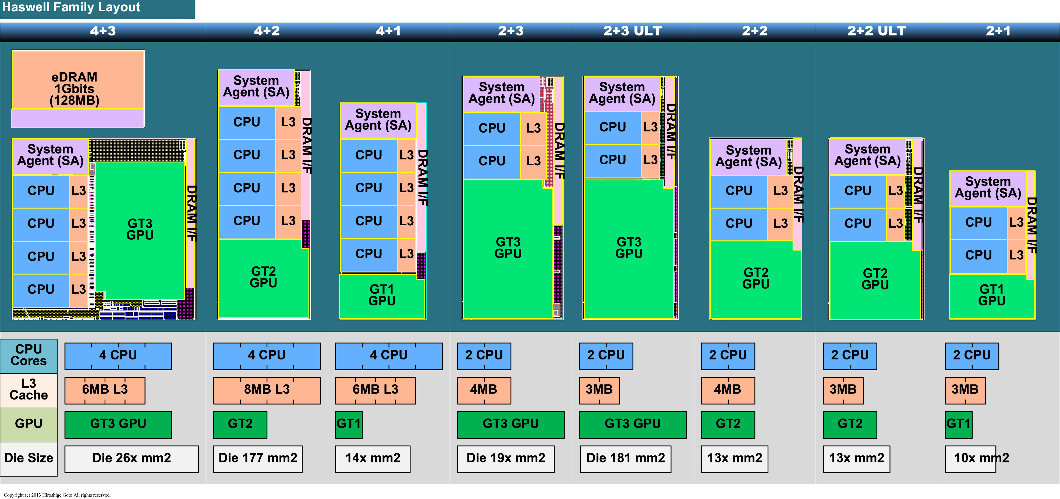
Haswell Family FloorPlans

Slide 8
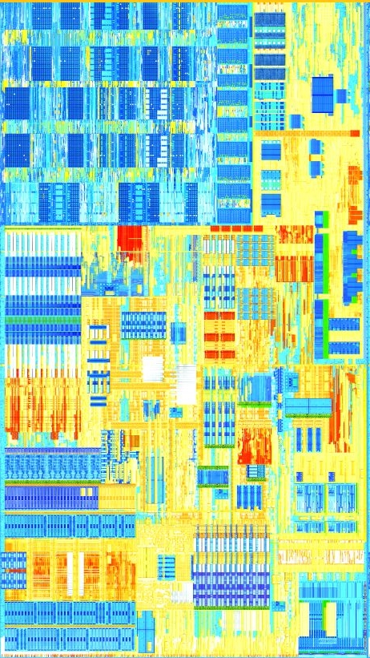
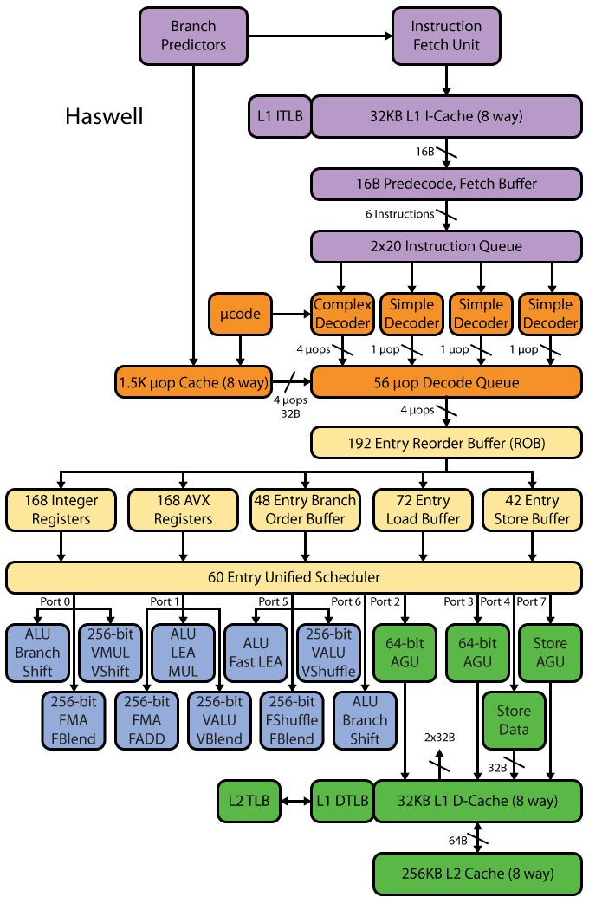

Block Diagram
FloorPlan Map
Front End
EXE
OOO
MEM
OOO
FE
EXE
MEM

Slide 9
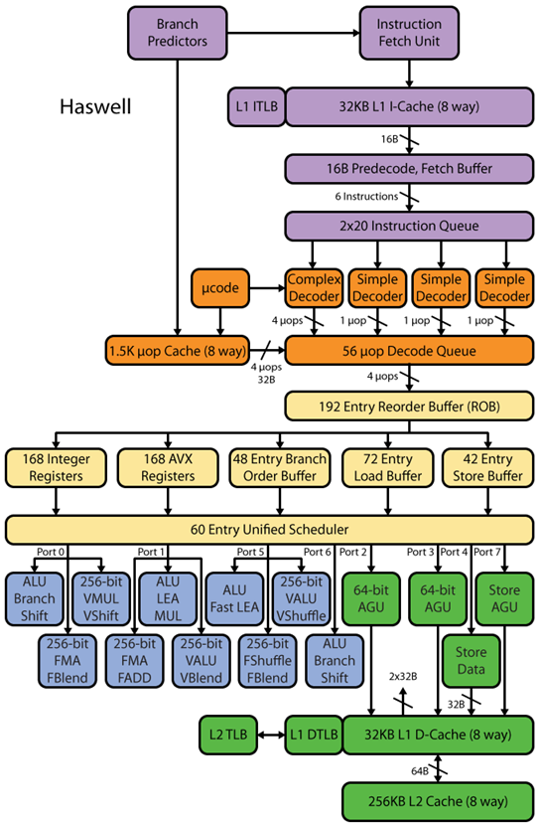
Front End
Instruction Fetch and Decode
32KB 8-way ICache
4 Decoders, up to 4 instructions / cycle
CISC to RISC transformation
Decode Pipeline supports 16 bytes per cycle
Cache of Decoded Uops

Slide 10
Front End: Instruction Decode
Four decoding units decode instruction into uops
The first can decode all instructions up to four uops in size
The remaining 3 decoders handle common single uop instructions
Uops emitted by the decoders are directed to the Decode Queue and to the Decoded Uop Cache
Instructions with >4 uops generate their uops from the MSROM
The MSROM bandwidth is four μops per cycle

Slide 11
Front End: Decoded Uop Cache
The UC is an accelerator of the legacy decode pipeline
Caches the uops coming out of the instruction decoder
Next time uops are taken from the UC
The UC holds up to 1536 uops
Average hit rate of 80% of the uops
Skips fetch and decode for the cached uops
Reduces latency on branch mispredictions
Increases uop delivery bandwidth to the OOO engine
Reduces front end power consumption
The UC is virtually addressed
Flushed on a context switch

Slide 12
Front End: Loop Stream Detector
LSD detects small loops that fit in the Decode Queue
The loop streams from the uop queue, with no more fetching, decoding, or reading μops from any of the caches
Works until a branch misprediction
The loops with the following attributes qualify for LSD replay
Up to 56 uops
All uops are also resident in the UC
No more than eight taken branches
No CALL or RET
No mismatched stack operations (e.g., more PUSH than POP)

Slide 13
Front End: Macro-Fusion
Merge two instructions into a single μop
Increased decode, rename and retire bandwidth
Power savings from representing more work in fewer bits
The first instruction of a macro-fused pair modifies flags
CMP, TEST, ADD, SUB, AND, INC, DEC
The 2nd inst. of a macro-fusible pair is a conditional branch
For each first instruction, some branches can fuse with it
These pairs are common in many types of applications

Slide 14
OOO Structures
 | Nehalem | Sandy Bridge | Haswell
Window (BOB) | 128 | 168 | 192
In-flight Loads (LB) | 48 | 64 | 72
In-flight Stores (SB) | 32 | 36 | 42
Scheduler Entries (RS) | 36 | 54 | 60
Integer Registers | Equal to ROB | 160 | 168
FP Registers | Equal to ROB | 144 | 168

Slide 15
OOO: Renamer
Rename 4 uops / cycle and provide to the OOO engine
Renames architectural sources and destinations of the uops to micro-architectural sources and destinations
Allocates resources to the uops, e.g., load or store buffers
Binds the uop to an appropriate dispatch port
Some uops can execute to completion during rename, effectively costing no execution bandwidth
Zero idioms (dependency breaking idioms)
NOP
VZEROUPPER
FXCHG
A subset of register-to-register MOV
The renamer can allocate two branches each cycle

Slide 16
OOO: Dependency Breaking Idioms
Move elimination
Moves just update RAT w/o real copy of register value
Example: eax is renamed to pr10,
after mov eax->ebx, ebx is also renamed to pr10
Instruction parallelism can be improved by zeroing register content
Zero idiom examples
XOR REG,REG
SUB REG,REG
Zero idioms are detected and removed by the renamer
Have zero execution latency
They do not consume any execution resource

Slide 17
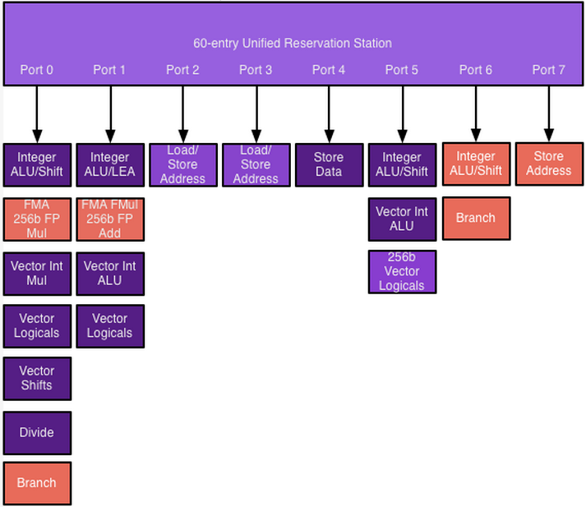
EXE

Slide 18
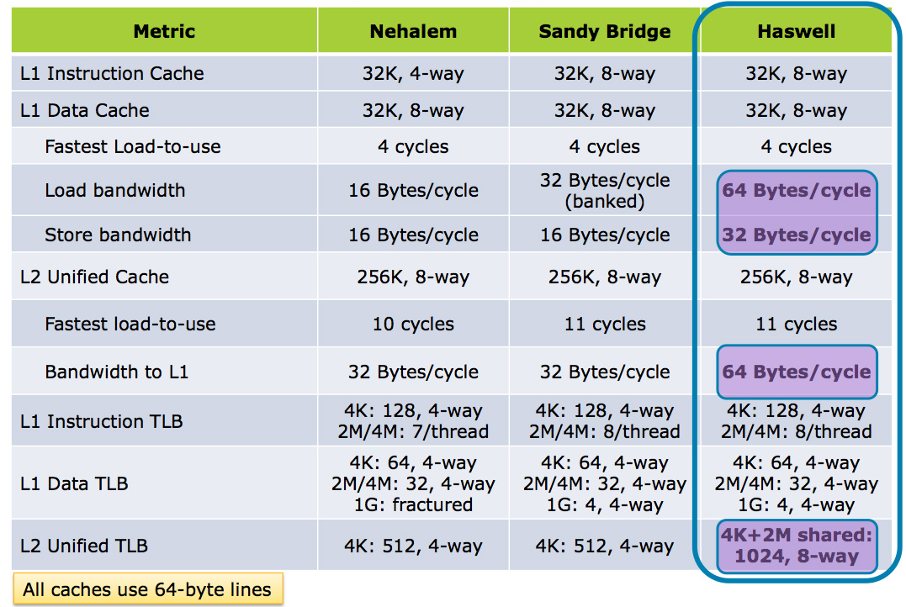
Core Cache Size/Latency/BW

Slide 19
ST vs MT
ST
1x width
ST
2x width
MT
4x width
4x area
1.5x perf
1x area
1x perf
1x area
1x perf
1x area
1x perf
vs
1x area
1x perf
1x area
1x perf
SMT
1x perf
1x perf

Slide 20
Block Diagram
FE 0
FE 1
OOO 0
OOO 1
EXE
MEM

Slide 21
Q & A

